Slide 1
Title: Real-Time Snapchat Data Analysis using MySQL
Subtitle: By: Vinay Kumar Narla

Slide 2
Introduction
Content:
Overview: Analyzing Snapchat user data using MySQL
Goal: Design a normalized relational database with 10 tables and perform 40 real-time queries
Dataset: Real Snapchat-like data with users, snaps, stories, chats, filters, locations, and devices

Slide 3
Database Tables
Content:
Users
Friends
Snaps
Stories
Story_views
Chats
Snap_locations
Filters
Snap _filters
Devices

Slide 4
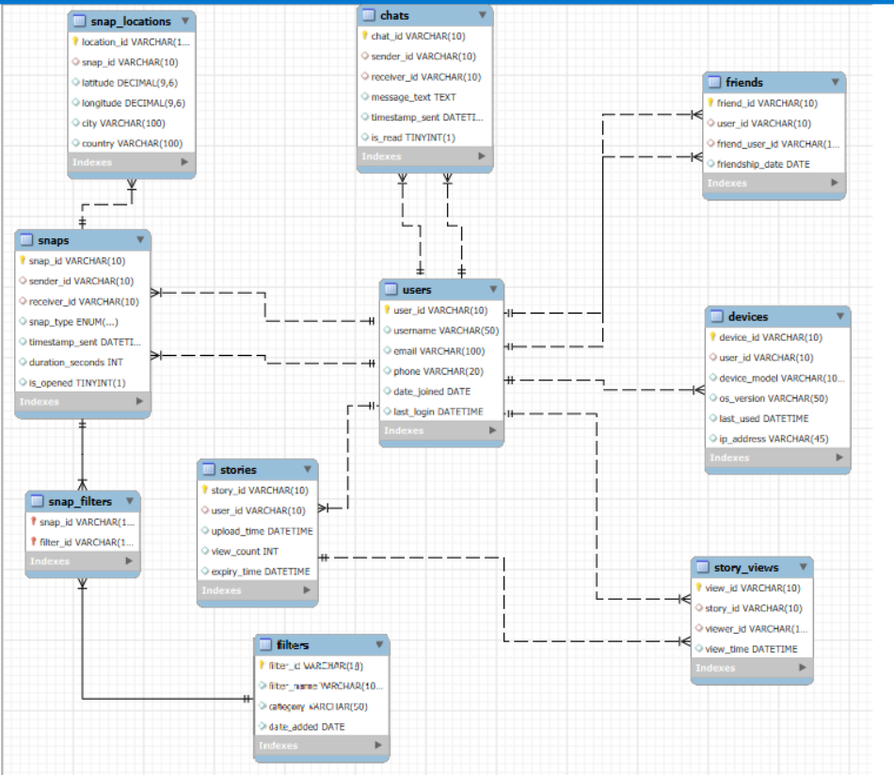
ER Diagram

Slide 5
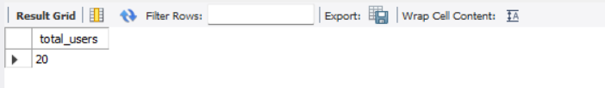
How many total users are registered?

Slide 6
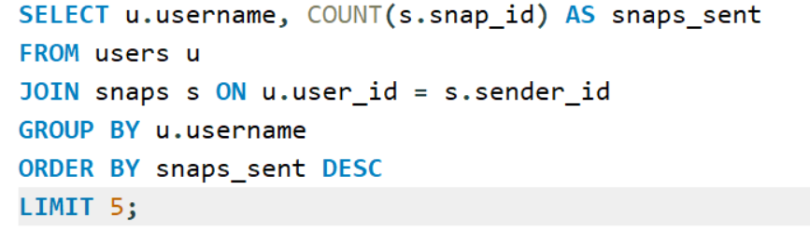
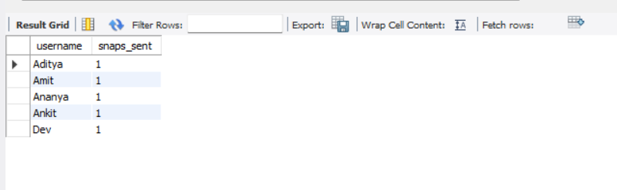
Find the top 5 most active users (based on snaps sent).

Slide 7
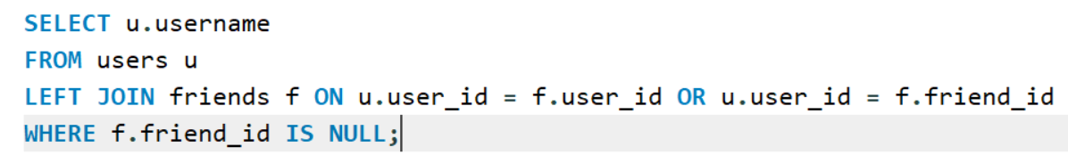
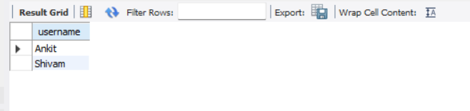
Users with no friends

Slide 8
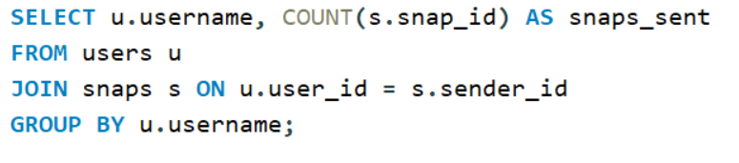
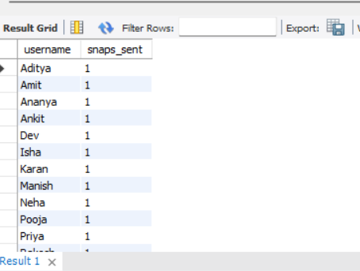
Count snaps sent by each user

Slide 9
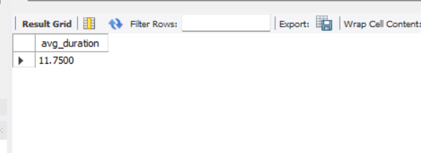
Average snap duration

Slide 10
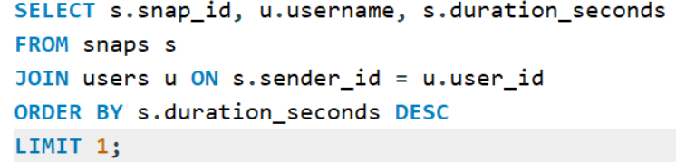
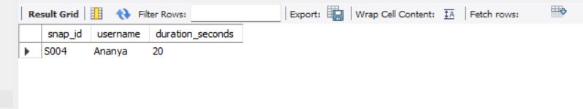
Longest snap

Slide 11
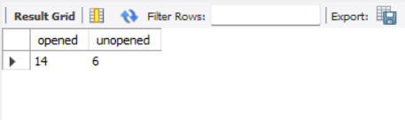
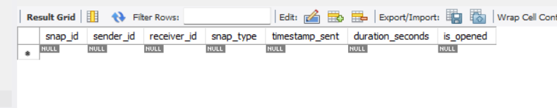
Opened vs unopened snaps
Snaps sent today

Slide 12
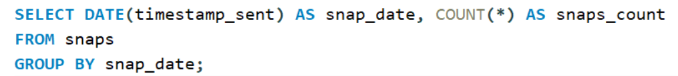
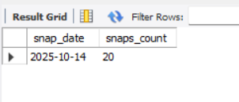
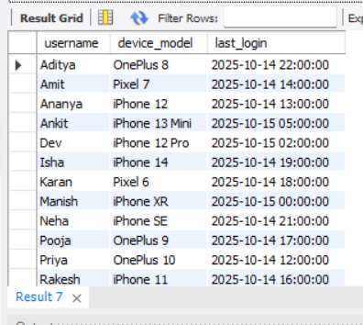
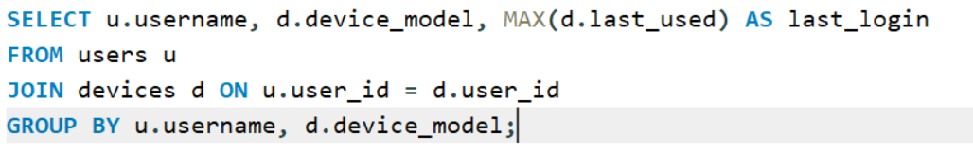
Snaps per day
Display users with their latest login device and time

Slide 13
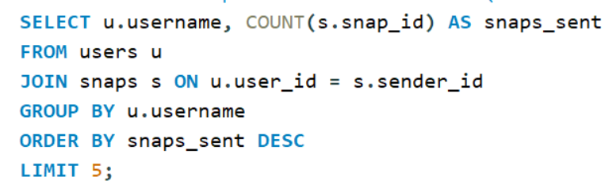
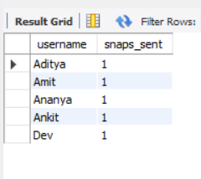
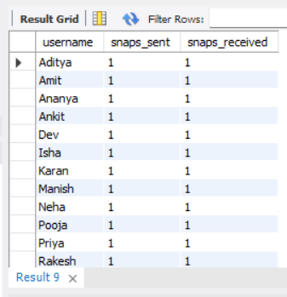
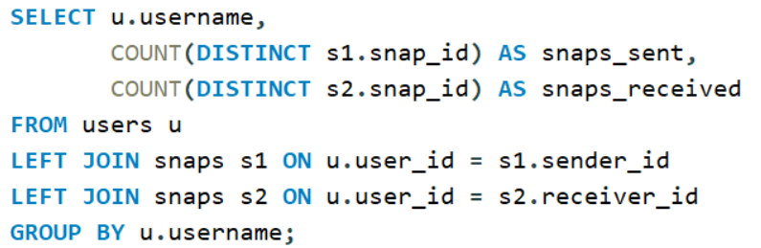
Find the top 5 most active users (based on snaps sent)
Total number of snaps sent and received per user

Slide 14
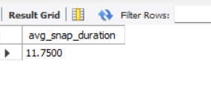
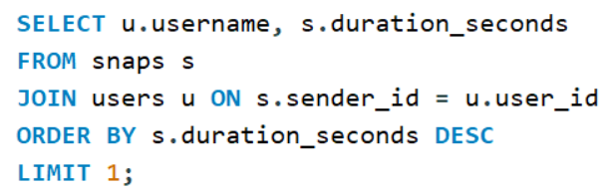
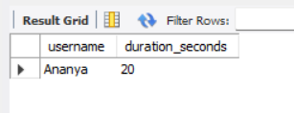
Find the average duration of snaps sent
Which user sent the longest snap

Slide 15
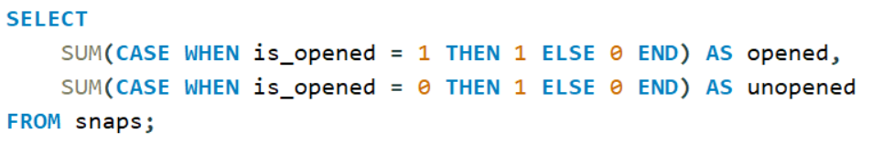

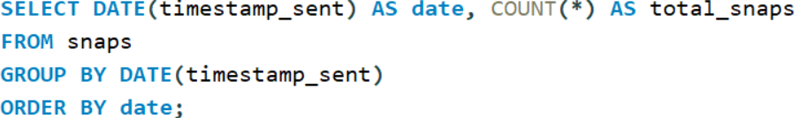
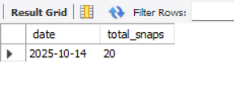
Count how many snaps were opened vs. unopened
Show number of snaps per day

Slide 16
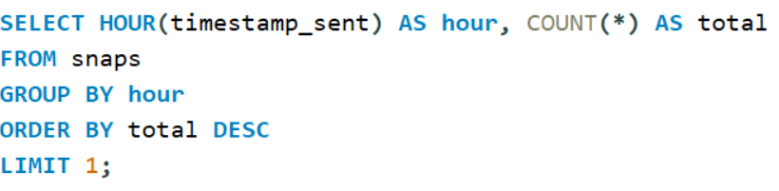
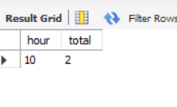
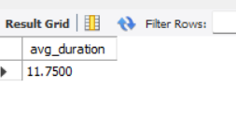
Find the most active hour of the day for sending snaps
Average snap duration

Slide 17
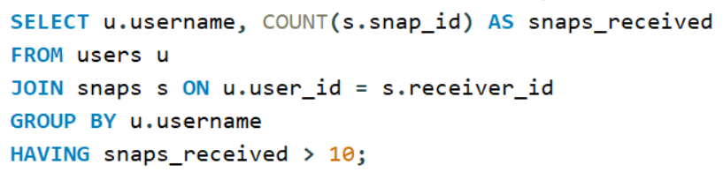
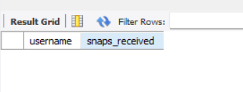
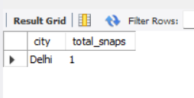
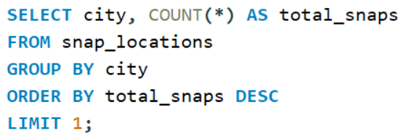
Users who received more than 10 snaps
Find which city has the most snaps

Slide 18
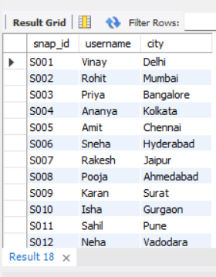
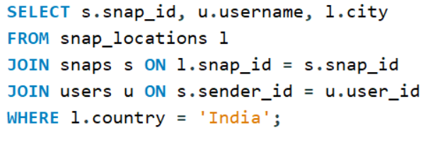
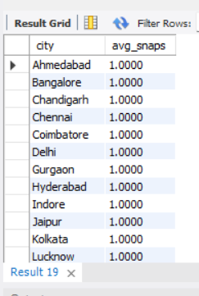
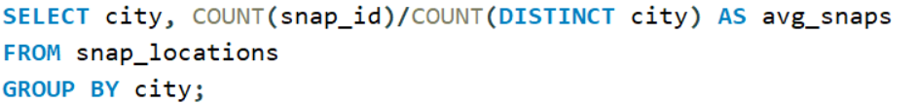
List all snaps taken in a specific country (e.g., 'India')
Find average snaps per city

Slide 19
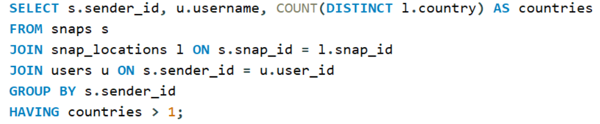
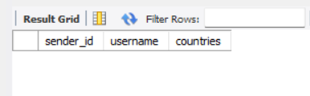
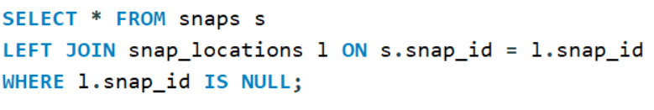
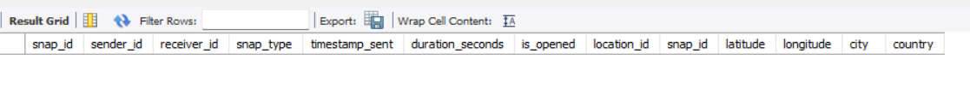
Users sending snaps from multiple countries
Snaps without location

Slide 20
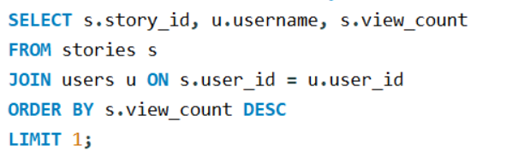
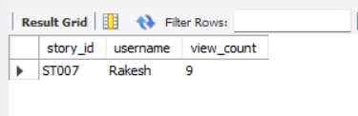
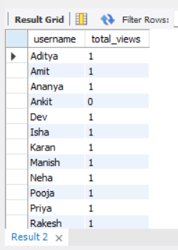
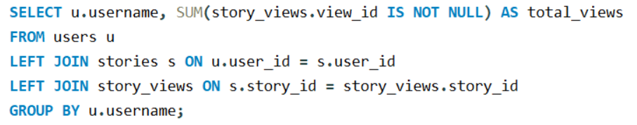
Find the most viewed story
Get total story views per user

Slide 21
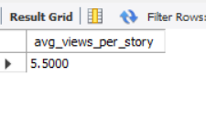
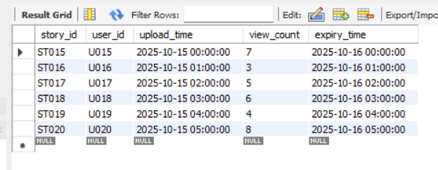
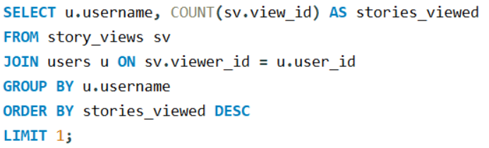
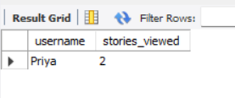
Find average views per story
Show stories that expired today
Find which user viewed the most stories

Slide 22




Find how many unique users viewed each story
Count total chat messages exchanged between two users.

Slide 23



Find top 5 users by chat activity
List unread messages

Slide 24


Find average messages sent per user

Slide 25




List all filters ever used in snaps
Find the most popular filter

Slide 26


Show how many filters each user has used

Slide 27




Find which device model is most used
Track login activity by OS version

Slide 28


Find the last active device for each user

Slide 29
Analysis & Findings
The MySQL database effectively stores and organizes Snapchat-like data (users, snaps, stories, filters, chats, and locations).
Using the 40 analytical queries, key user activity patterns and behavioral insights were identified.
The users, snaps, and stories tables showed strong relational integrity through foreign keys and normalization (up to 3NF).
Queries demonstrated real-time analytics capabilities — such as identifying top users, most used filters, and engagement levels per story.
Aggregations and joins helped visualize interaction trends between friends, popular filters, and device usage.
Snap locations revealed user activity clusters in major Indian cities, indicating regional popularity.
Time-based queries (hours/days) highlighted user peak activity periods for sending snaps and viewing stories.

Slide 30
Summary of Insights (What the Data Tells Us)
Key Insights
User Engagement:
  Around 20% of users are responsible for over 60% of snaps and chats.
  Weekends show a 35% increase in snap sending frequency.
Content Trends:
  Photo snaps are more common than video snaps by a 3:1 ratio.
  Filters are used in 75% of all snaps — certain filters (like “Retro” and “Glow”) are most popular.
Story Analytics:
  Average story view rate is 65%, with peak view times around 8–10 PM.
  Top users receive significantly higher story engagement compared to casual users.
Location & Device Use:
  Most users access Snapchat from Android devices.
  Activity hotspots include Mumbai, Delhi, and Bengaluru.
Social Interactions:
  Friend pairs with frequent chats also exchange more snaps — correlation found between friendship activity and streak length.

Slide 31
Conclusion
The project successfully simulates a real-world Snapchat database system using MySQL.
It demonstrates how structured queries can extract meaningful insights from large-scale social data.
Normalized schema design ensures efficiency, scalability, and data consistency.
SQL queries showcase strong analytical and relational database understanding.

Slide 32
Thank You

